Slide 1
Mode-Decomposition-Based Equivalent Model of High-Speed Vias up to 100 GHz
Davit Kharshiladze
Yifan Ding
Chulsoon Hwang

Slide 2


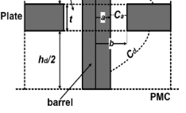
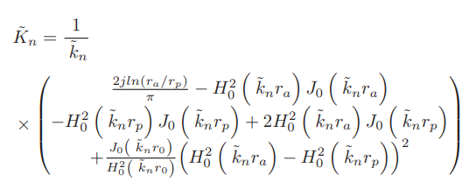
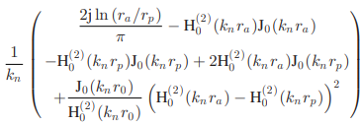
Analytical Expression For Barrel Capacitance
Calculating barrel capacitance between via’s barrel and parallel plates is imperative in finding an accurate via model. Slight problem was observed in the paper and the problem is underlined on this slide
According to Paper [1]
According to Paper [2]
Via Model Cross-section
Via Barrel Capacitance
[1] C. Li, K. Cai, M. Ouyang, Q. Gao, B. Sen and D. Kim, "Mode-Decomposition-Based Equivalent Model of High-Speed Vias up to 100 GHz," in IEEE Transactions on Signal and Power Integrity, vol. 2, pp. 74-83, 2023
[2] M. Friedrich, C. Bednarz, and M. Leone, “Improved expression for the via-plate capacitance based on the magnetic-frill model,” IEEE Trans. Electromagn. Compat., vol. 55, no. 6, pp. 1362–1364, Dec. 2013, doi: 10.1109/TEMC.2013.2265041.

